Slide 1

Auto-reporting tools

Slide 2

Agenda
Opening remarks and agenda adoption;
Quick recap on what is new:
  Use cases WG
  Specification template
5 selected presentations on themes proposals (more in the next meetings)
How ITU process works
AOB

Slide 3
NEW! Use Cases WG
WG on use cases and it is now accepting submissions in the use cases repository.
Why?
Use cases ground the Focus Group's work in concrete situations: who is acting, what they are doing, what fails today, and what would need to exist for it to work. They will feed into theme scoping and, in turn, into FG-TIDA's deliverables.
To contribute:
Open a new Issue in the repository and complete all required fields. (template was presented during last call)
Once your issue is open, add a row to the index table in the README with a link to it.

Slide 4
NEW! Use Cases WG
A warm thank you to those who have already submitted use cases
WE HAVE 12 use cases submitted
→ go and discover what your peers have submitted already here
Submissions from all sectors and perspectives are welcome
NEXT STEPS:
- TIDA management team to qualify and classify the use cases
- Dedicated session at TIDA in person meeting

Slide 5
NEW! Specification Template
We have a common specification template for FG-TIDA specifications and documents.
For a working example, see the RA-AAI document, which already uses this setup: here is the published HTML version and its source folder.
Documents are written in .rst (very similar to Markdown, but better suited to specifications that describe APIs).
Contributors only need to add text to the chapter files and commit/push to GitHub. The HTML version, and a PDF, are then built automatically.
As we graduate themes to WGs, we will start working on specifications/documents using this template.

Slide 6
Let us brainstorm together on ideas for Working Groups
Reminder: Fix WGs by Nov 30th

Slide 7
Selected presentations on proposed themes
  Theme #22: Remote Attestation for Agentic AI (RA-AAI)
  Theme #25: [Theme] Age-Aware Identity and Delegated Authority for Agentic AI
  Theme #23: [Theme] Security framework and requirements for authorization and privilege lifecycle management of AI agents
  Theme #18: [Theme] Trustworthiness of multi-objective agentic AI: a collective-choice formalism
  Theme #2: [Sovereign Discovery] ++ Modularity
Notes:
Approach bottom up → what we need from you

Slide 8
5 virtual meetings from now to 30 Nov -1 Dec
29th of July @2pm CET
2nd of September @2pm CET
(today) 30th of September @2pm CET
CONFIRMED! 14th of October @2.30pm CET
4th of November @2pm CET
Notes:
Approach bottom up → what we need from you

Slide 9

Engage in our GitHub space!
TIDA · GitHub
Notes:
Open the Terms of Reference

Slide 10
THANK YOU FOR YOUR PARTICIPATION

Slide 11
Why creating TIDA?
As AI agents begin to negotiate, transact, and act autonomously on our behalf, the world lacks common international foundations to establish who these agents are, when they can be trusted, and how humans remain in control: FG-TIDA was created to build that foundation before agentic AI becomes ubiquitous
Our objective is to define architectural models and interoperability frameworks that establish trust in agentic AI.
As part of the UN, we bring together an inclusive, global community of Member States, academia, and industry to build this foundation together.

Slide 12
What is a Focus Group in ITU?
TIDA Focus Group is
An Open Community (no need to be member of ITU to participate)
conducting pre-standardization work

Slide 13
Pls subscribe to our Mailing List
Please subscribe to the mailing list here:
https://www.itu.int/en/ITU-T/focusgroups/tida/Pages/default.aspx
→ From Dec 1st I will ONLY use the mailing list to send meeting invitations

Slide 14
What is happening next?
7 Sep 2026
2nd SG17 Content Week, Chongqing (China)
Two SG17 workshops: ITS/CAV security · Secure Agentic AI
7 Oct 2026
Interim SG17 plenary (virtual)
Progress checkpoint
30th Nov –1 Dec 2026
FG-TIDA 1st meeting, Paris
With the Digital Trust Convention at the OECD on 4 December
9 Dec 2026
Interim SG17 plenary (virtual)
Progress checkpoint
25* Jan 2027
SG17 workshop, Geneva
Open to all participants
26 Jan 2027
FG-TIDA meeting, Geneva
Focus Group working session
18–29* Jan 2027
6th SG17 Plenary, Geneva
Next full plenary

Slide 15
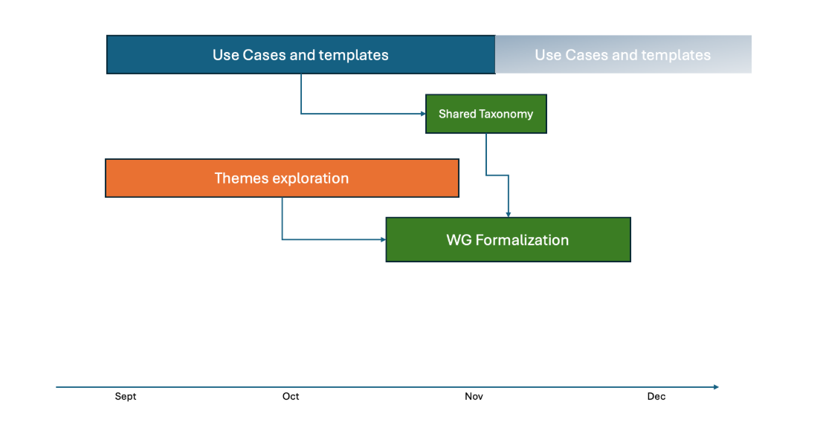
Our timeline for 2026
Notes:
Open the Terms of Reference

Slide 16
Our Objective for 30th Nov – 1st Dec meeting
Formally announce the Focus Group's structure and leadership
Publish an initial definition of deliverables on GitHub
Advance the technical work during the in-person meeting
Notes:
Approach bottom up → what we need from you

Slide 17
Current TIDA Structure

Slide 18
Introduction to the Use Cases work
Notes:
Which prez from workshops to add as reference?
Contributions are driven by the community
Technical Development rather than policy work. We are in a position of solution architect even if not everything is done by SG17.

